Slide 1
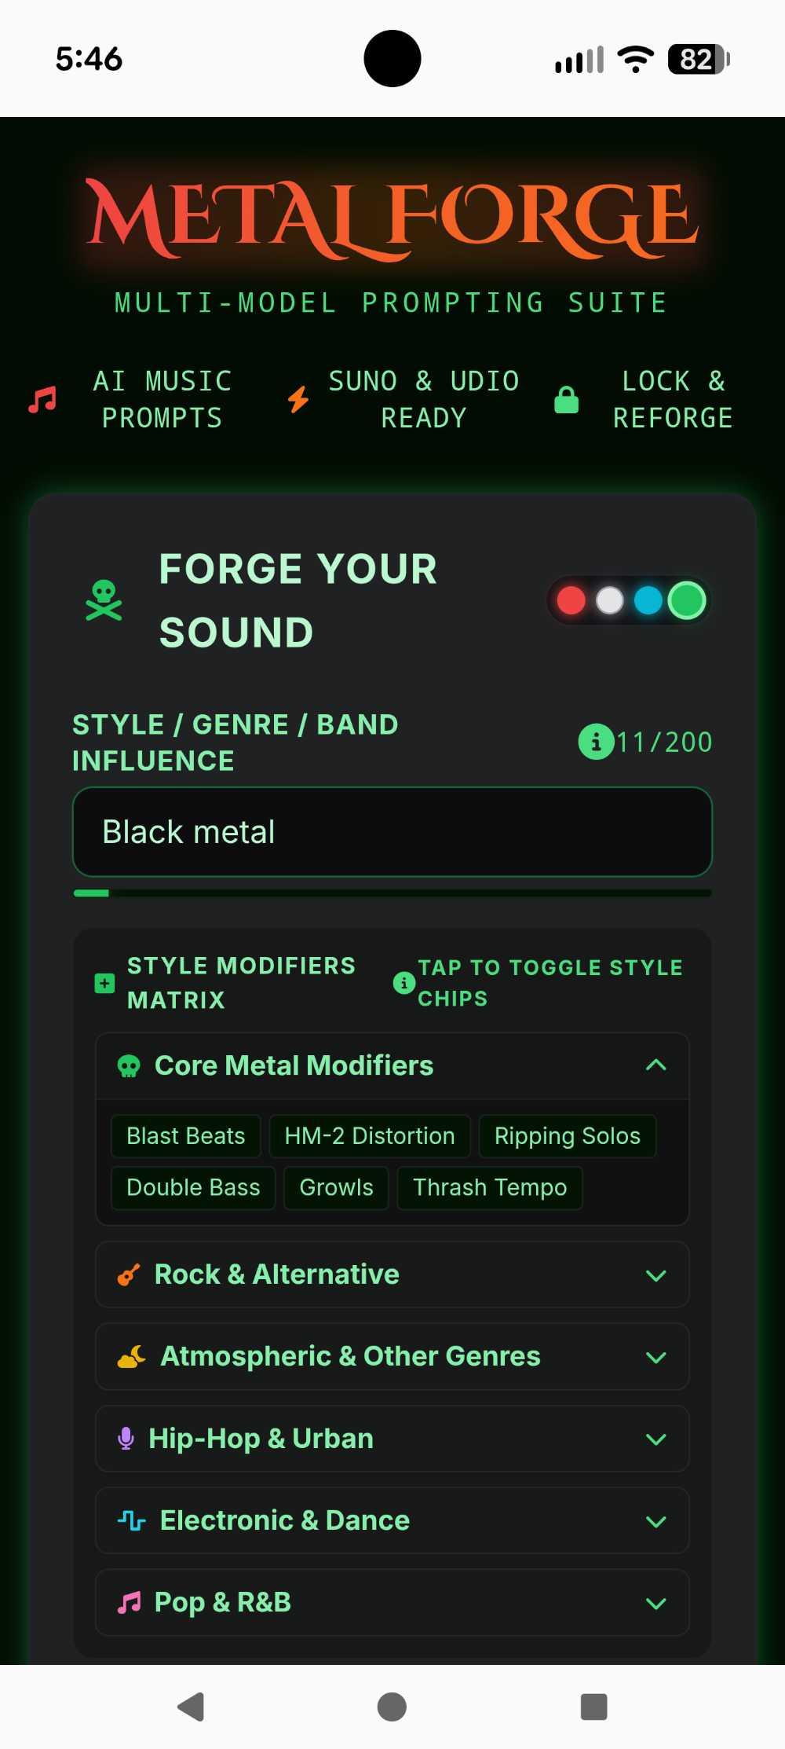
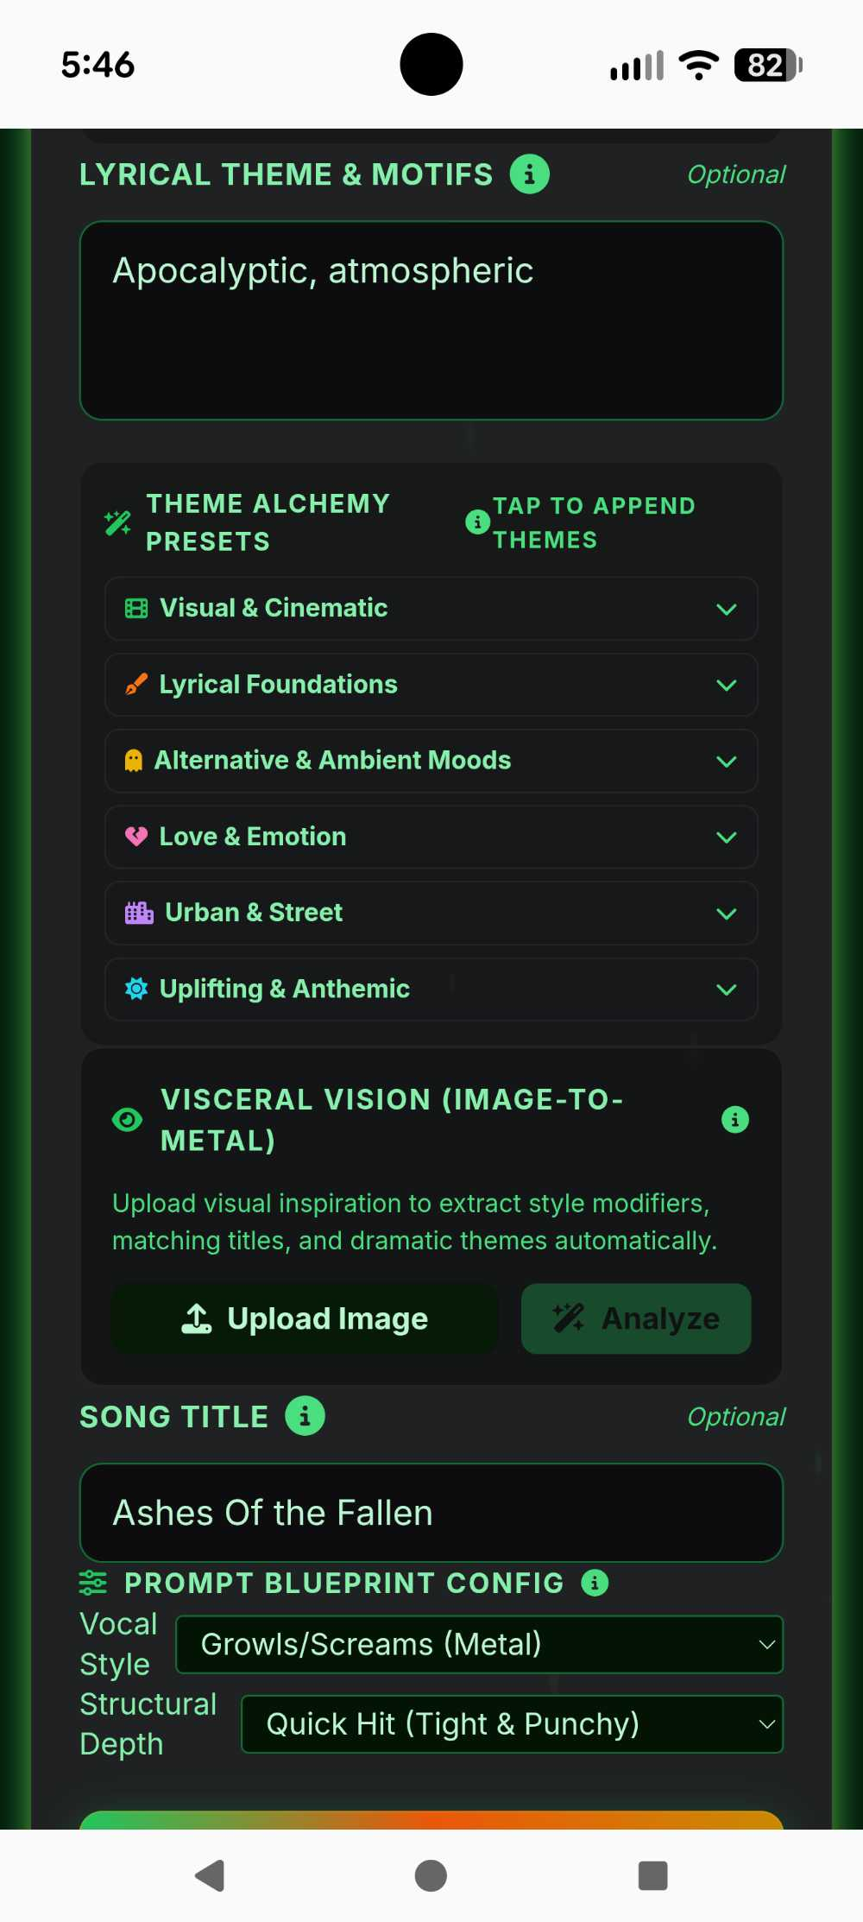
STOP GUESSING.
START FORGING.
AI music prompts built for Suno & Udio

Slide 2
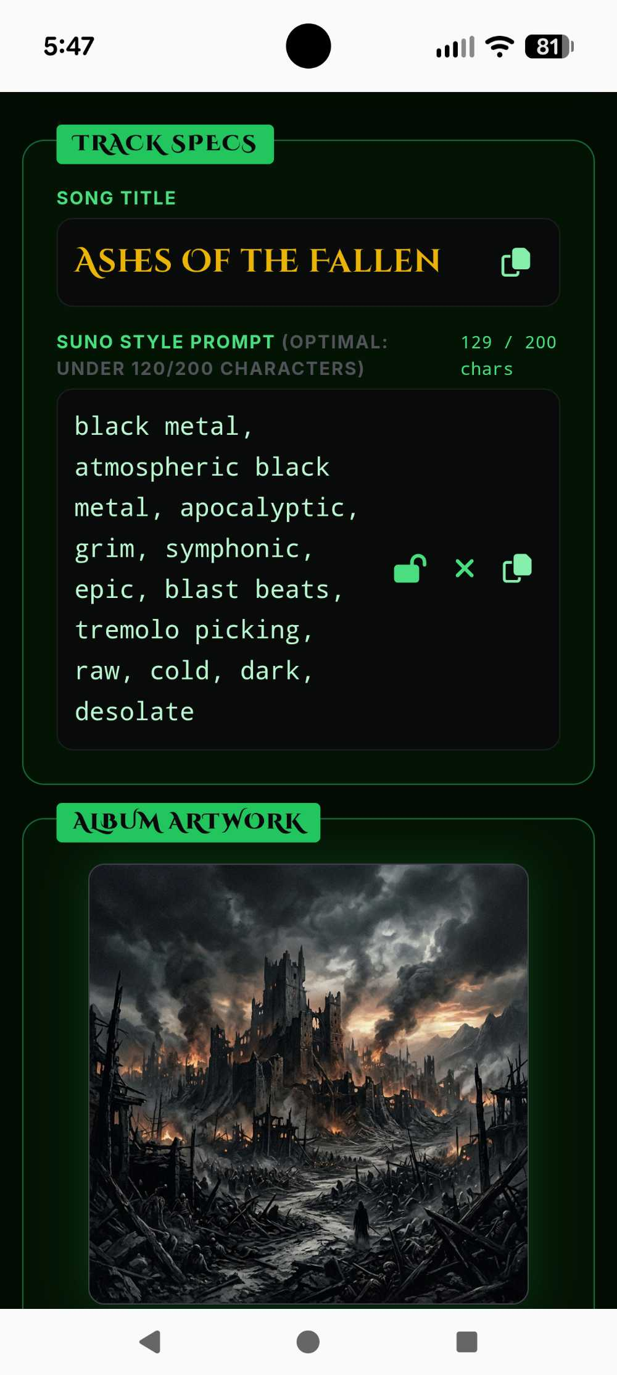
PRECISION-ENGINEERED PROMPTS.
Ready to drop into Suno or Udio

Slide 3
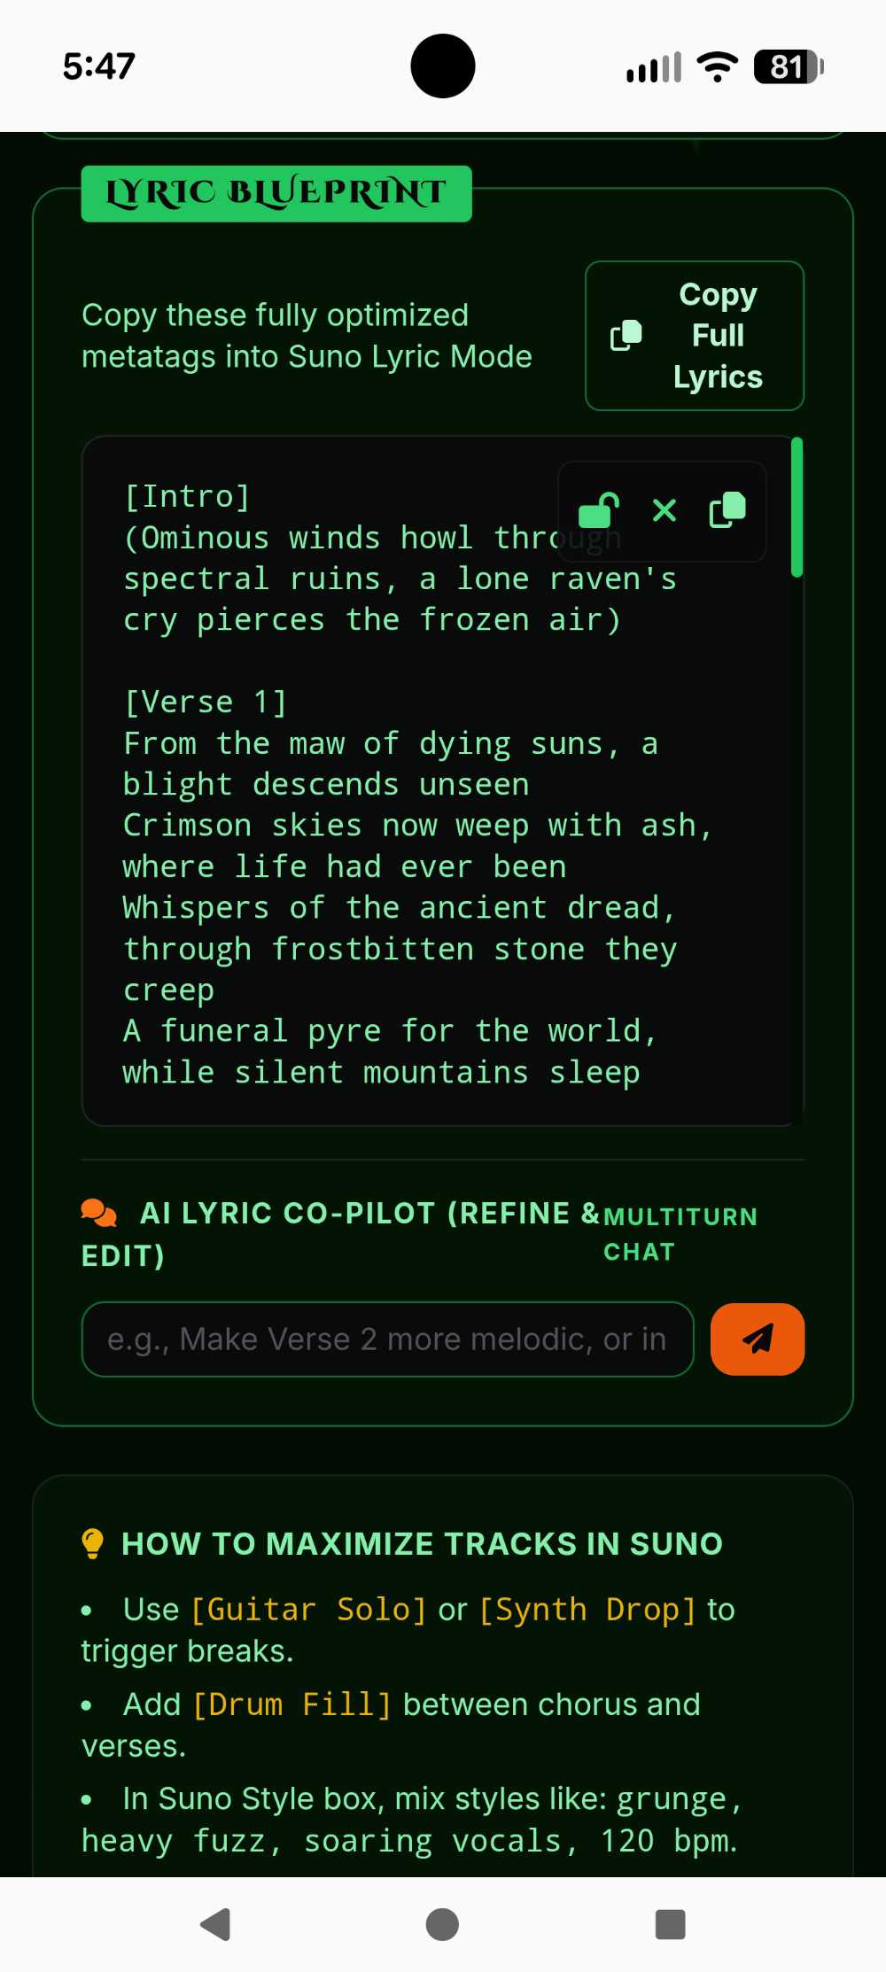
FULL SONGS.
VERSE TO HOOK.
AI lyrics with structure – ready to use

Slide 4
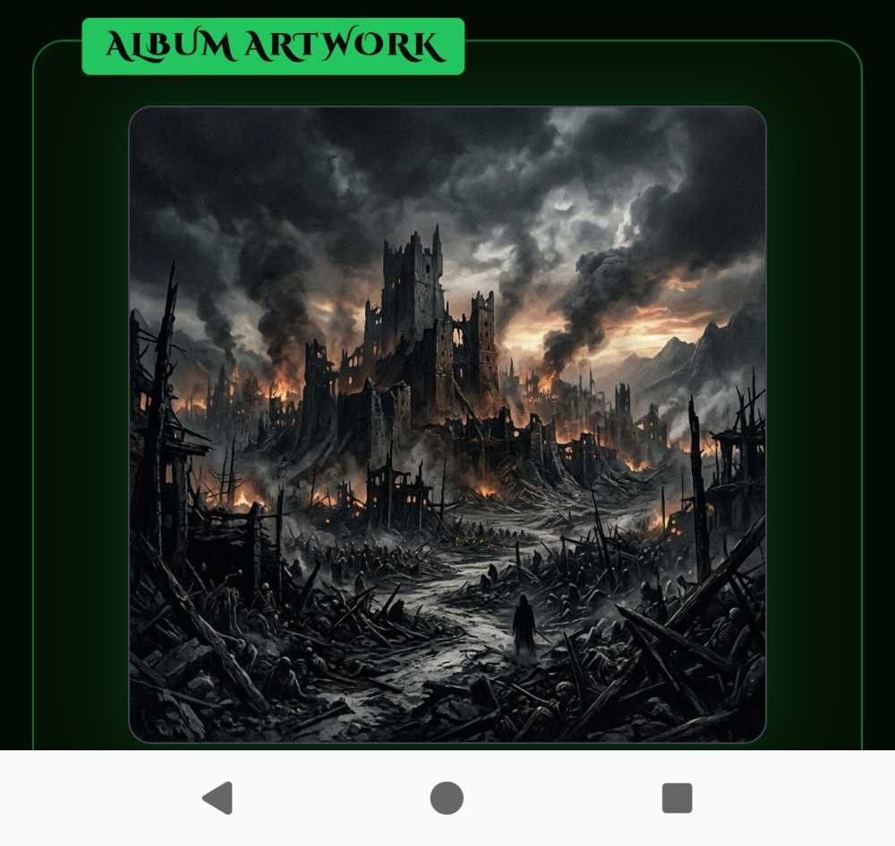
YOUR SOUND,
VISUALIZED.
AI album art generated from your concept

Slide 5
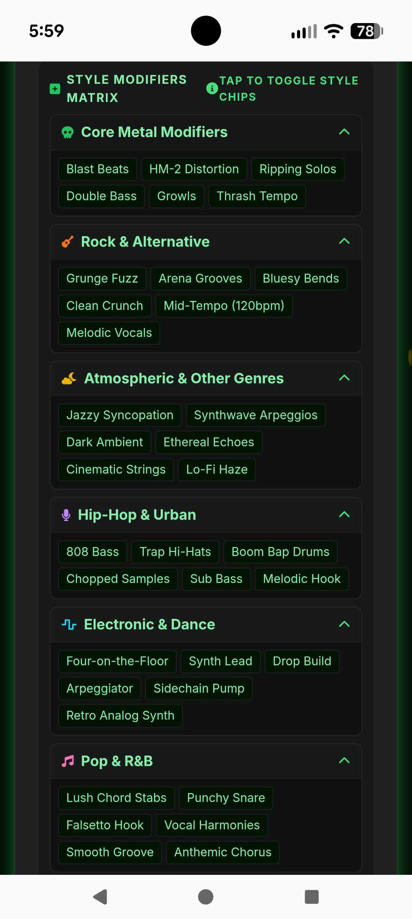
EVERY SUBGENRE.
DIALED IN.
Tailored prompt logic for every style

Slide 6
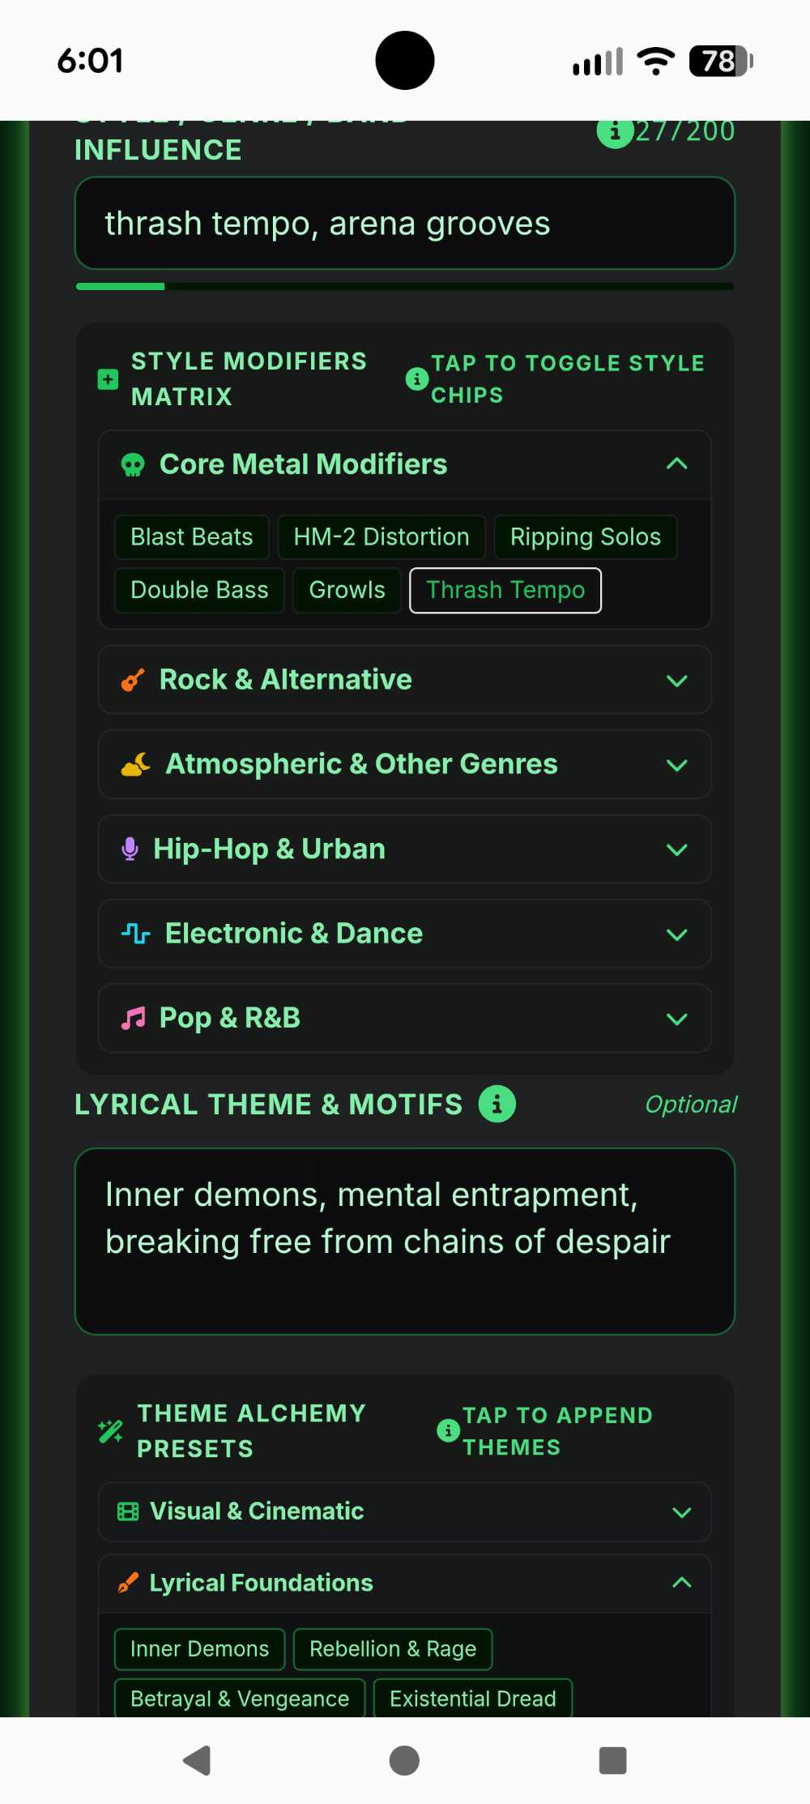
YOUR VISION.
YOUR PARAMETERS.
Genre, mood, theme – you control the output

Slide 7
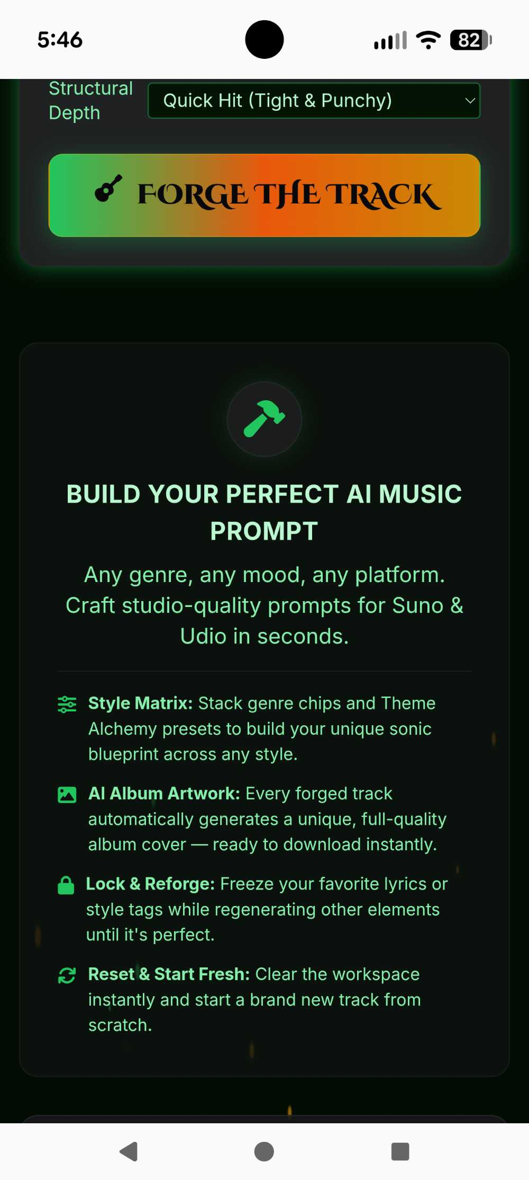
ONE SESSION.
COMPLETE OUTPUT.
Prompts, lyrics, and artwork in Metal Forge

Slide 8
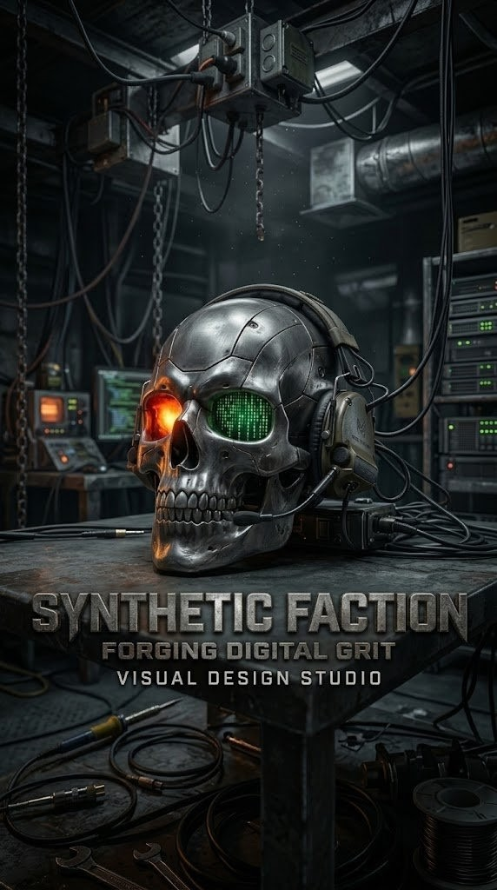
5 DAYS FREE.
NO CREDIT CARD.
Full access from day one – monthly or annual subscriptions

